Slide 1
Variables
Programming – Introduction to C++
Last modified 27/01/2016 by Jeff Cotter

Slide 2
Contents
Data Types
Sizes
Mathematical operators
Naming variables
Input & Output
Variable scope

Slide 3
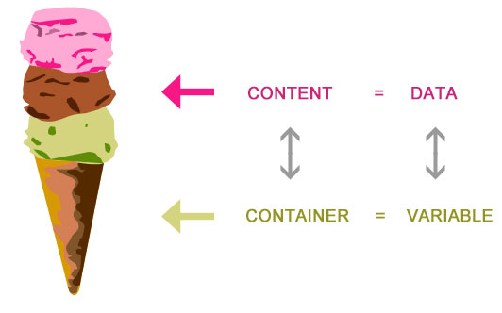
What are Variables?
Variables are storage space in memory (RAM) for the data we want to use in our programs
Variables form the building blocks of any program
Variables have a name, (an alias for a physical memory location)
Variables can be read from or written to
They are called variables because they represent information that can change
Notes:
Some clever students might ask if there are constants or “variables that can’t change”. This is coming up in future lectures.

Slide 4

Primitive Variables
C++ provides us with a set of variable types for us to use
These are known as primitive data types
They come in two flavours
integral (whole numbers)
floating-point (fractional numbers)

Slide 5
Integral types
Store a finite range
Exceeding this range will cause the value to overflow and wrap around
Have two flavours
signed (they can be negative)
unsigned (no negative values)
Notes:
Store a finite range – they can only store up to a certain number. There is an upper limit on what an integral type can store. It makes sense that they are not infinite.
Signed means it can be positive OR negative.
Unsigned is only positive.

Slide 6
Integral Types
Non-Numerical integral types
bool (true or false)
char – represents a character in the ascii character table
Numerical Types
short (2 bytes)
int (4 bytes on x86, 8 bytes on x64 )
char (1 byte) doesn’t always need to represent a character
Notes:
Explain that int stands for integer (not integral, and there is only one r in integer)

Slide 7
Declaring variables
To create a variable in C++ we need to first write the data type followed by the name we want to give our variable
We can declare multiple variables on the same line if they are the same type:
char someLetter;
int aNumber;
bool trueFalse;
char a, b, c;
int aNumber, anotherNumber;

Slide 8
Setting variables
We can set variables as they are created (initialisation):
You should always provide default values to all variables when they are defined
int aNumber = 7;
int anotherNumber = 10;
char letter = 'A';
aNumber = -4;
Notes:
Point out the notation for a character – single quotation marks. Perhaps show them the wrong way of doing it: char letter = A;
Here you could even jump to visual studio and show them char letter = 65. So, how chars are really just integers. Bring up an ascii table to show how the letters correspond to numbers.

Slide 9
Floating Point Types
Floating point variables contain a fractional component
In memory, floating point numbers are processed in a much more complex manner than whole numbers
float | A single precision variable, has an accuracy to 7 decimal places
double | A double precision variable, has accuracy to 15 decimal places
Notes:
These are decimals!

Slide 10
Declaring and Using Floating Point Numbers
float floatValue = 13.245f;
float i = 13.245; // double is casted to float
double SomeDouble = 13.245;
What is that f?
The f informs the compiler that the number is a float, otherwise it assumes it is a double (like in the third line)

Slide 11
Naming your Variables
Use intuitive variable names!
Good, readable code is self documenting and easy to read
This comes from naming variables appropriately
Good variable names should be descriptive (nouns)
score, health, ammo, damage
Bad variable names should be avoided
A, number, thing

Slide 12
Variable Naming Conventions
No spaces or punctuation allowed
Variable names can’t start with a number
To make variables with multiple words in them, use a naming convention called Camel Case
The letter of each word is capitalised, except for the first
i.e. playerHealth, ammoRemaining

Slide 13
Reserved words
Some words cannot be variable names because they are key words in C++:
and auto break case catch
class continue default delete else
explicit export extern false for
friend mutable namespace new not
operator private protected public register
return signed static switch template
this throw true try typename
union unsigned using virtual volatile

Slide 14
Mathematical operations
We can apply operations to our variables just like we can in maths
The mathematical operators available to us are:
Addition (+)
Subtraction (-)
Multiplication (*)
Division (/)
Modulus (%)
Increment (++)
Decrement (--).
int x = 1 + 2;
int y = 5 - x;
int z = x * y;
Notes:
There are actually a few more, but we don’t need to learn about them right now.

Slide 15
Modulus
The % symbol does not represent percentage!
The modulus operator divides one number by the other and returns the remainder
For example:
5 % 2 will return 1, since 5 divided by 2 is 2 with 1 remainder

Slide 16
Increment and decrement
int num1 = 5;
num1++;
std::cout << num1;
These operators will add one or subtract one from a variable
The placement of the ++ (or --) is important. Placing it after the variable is called post-increment. This means the variable is incremented after it has been used within a statement
Placing the ++ (or --) before the variable is called pre-increment. This means the variable is incremented before it is used
int num1 = 5;
int num2 = num1++;
int num1 = 5;
int num2 = ++num1;
Notes:
Make sure you demonstrate all these pieces of code, or at least talk about what the answers are.
Also might be a good idea to mention that it is a bad idea to combine incrementers within the same statement since the behaviour is undefined

Slide 17
Operator precedence
This works the same way that it does in mathematics
Multiplication and division take precedence over addition and subtraction
And we can use parentheses (brackets) to force some operations to occur before others
int x = (5 + 3) * 10;

Slide 18
Integer division
What will be the value of answer after the following line of code runs?
The result we get is 0
An integer divided by another integer will give us an integer. So, the decimal part of the answer is cut off
float answer = 1 / 2;
Notes:
Hammer home the idea that the decimal part is cut off and not rounded. So, 9/10 is still 0, and not 1.

Slide 19
Type conversions
The problem on the previous slide can be solved by ensuring the numbers are floating point i.e. (1.0 or 2.0f)
So if we divide an integer by a float – what data type do we get?
Test the following:
We can force a variable to be a different type, but we will learn about this later
float answer0 = 1.0f / 2;
float answer1 = 1 / 2.0f;
float answer2 = 1.0f / 2.0f;
Notes:
Show them: float x = 10.0/5;

Slide 20
Outputting variables
We can output variables to the console:
We can output multiple variables by placing the << operator before each variable:
int number = 5;
std::cout << number;
int number = 5;
char letter = 'A';
std::cout << number << letter;
Notes:
Also show them how to output string literals: std::cout << “The number is: “ << number;
If they did the previous lab where they were chaining strings and endl then they should be fine.

Slide 21
Input
We can now collect input from the user by storing their data in variables
To do this, use cin and the stream extraction operator >>
int number = 5;
std::cin >> number;
Notes:
Don’t forget to #include <iostream>

Slide 22
Input
We can also input multiple values with the same cin statement:
The >> operator skips whitespace characters – spaces, tabs and newlines
What will be stored in letter1 and letter2 if the following data is input? AB
int num1, num2;
std::cin >> num1 >> num2;
char letter1, letter2;
std::cin >> letter1 >> letter2;
Notes:
Demo this one and show them that they need to put a space between inputs. And then the second one kind of wrecks that – you can explain about the input buffer at this point, or just show them that leaving a space between the A and the B gives the same result.

Slide 23
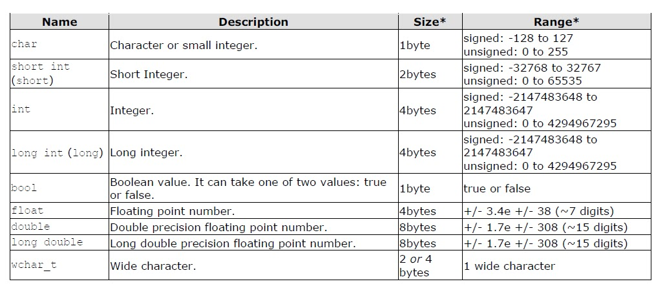
Size of data types
Different data types take up different amounts of memory
Notes:
* The values of the columns Size and Range depend on the system the program is compiled for. The values shown above are those found on most 32-bit systems. But for other systems, the general specification is that int has the natural size suggested by the system architecture (one "word") and the four integer types char, short, int and long must each one be at least as large as the one preceding it, with char being always 1 byte in size. The same applies to the floating point types float, double and long double, where each one must provide at least as much precision as the preceding one.

Slide 24
Variable overflow and underflow
When a variable is assigned a value outside of it’s range then the variable overflows or underflows
When a variable overflows, its contents wrap around to that data type’s lowest value
short num = 32767;
std::cout << num << std::endl;
num = num + 1;
std::cout << num << std::endl;
The output for this will be:
32767
-32768
Notes:
I always use the example here of the original Pokemon games. When a pokemon was on level 255 and you levelled it up, it would overflow to level 0.

Slide 25
Variable scope
Once a variable is created it does not live forever
At some point it ceases to exist and the memory it used is released
A variable comes into existence once it is declared and is destroyed by the next closing curly brace }
int main()
{
int number = 5;
{
int x = 10;
}
number = x;
return 0;
}
Notes:
With the example above x ceases to exist on the very next line after it is created. So the line after the } will not compile since x no longer exists at that point.

Slide 26
Global variables
Global variables are variables that are defined outside of any curly braces in your file
These variables exist from the point of definition until the program closes
Global variables are automatically initialised to zero
However you should avoid the use of global variables! They when programs scail up, the become difficult to track and maintain. Global variables lead to poor program structure
Notes:
I will fail any student who uses global variables!!

Slide 27
Summary
Variables are the building blocks of programs – we will expand upon the topics we learned today over the next few weeks
The skills you learned today are things that will be used every day throughout your programming career, so it’s a good idea to understand them solidly now!

Slide 28
References
Gaddis, T, Starting Out with C++: From Control Structures Through Objects, 7th edition, Pearson Education (2012)
Dhaval, 2013, Fundamental data types, Programming Language
http://c-programing4u.blogspot.com.au/2013/04/fundamental-data-types.html

